Slide 1
Supermart Grocery Sales - Retail Dashboard

Slide 2
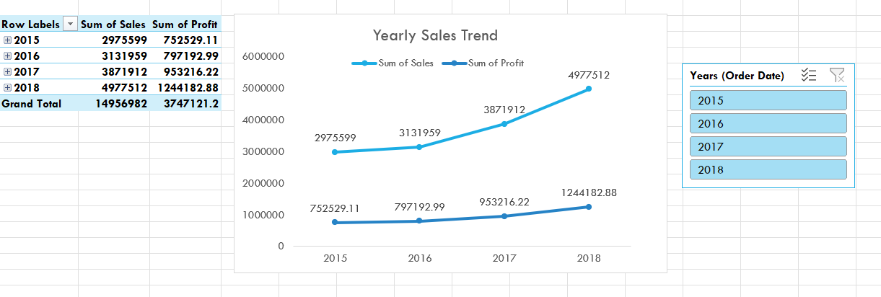
Yearly Sales Trend

Slide 3
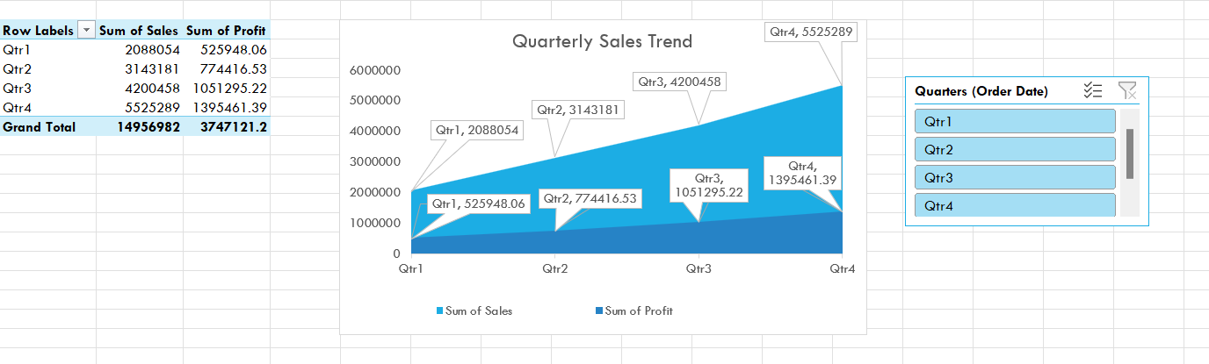
Quarterly Sales Trend

Slide 4
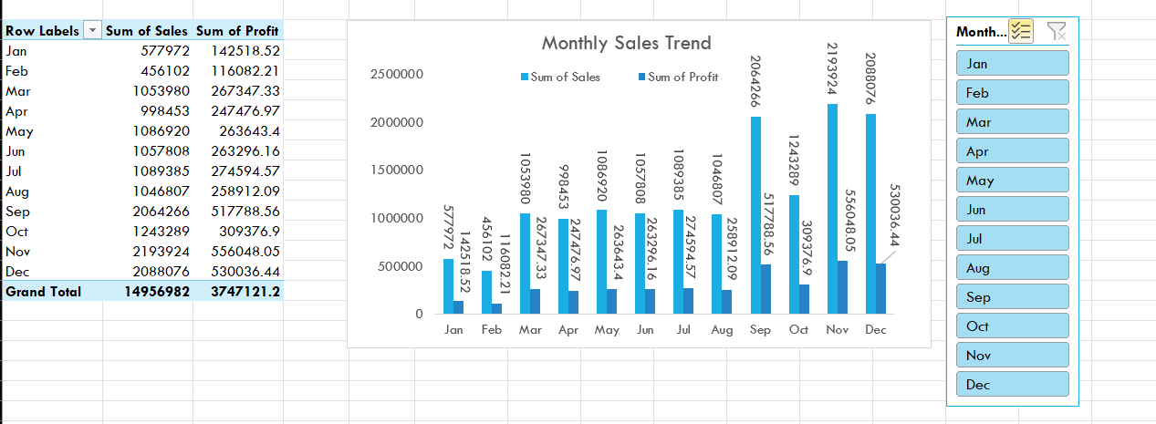
Monthly Sales Trend

Slide 5
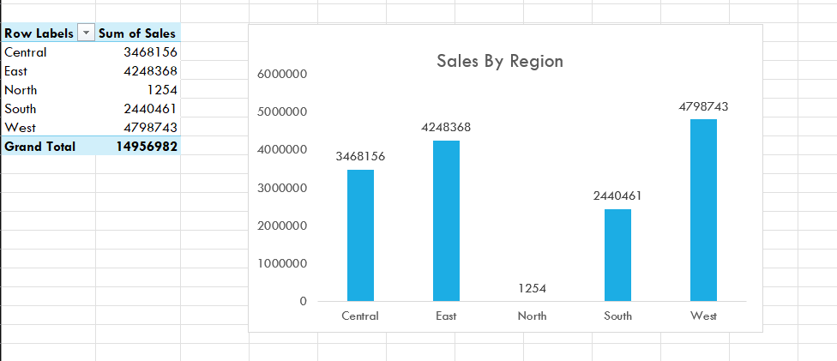
Sales by Region

Slide 6
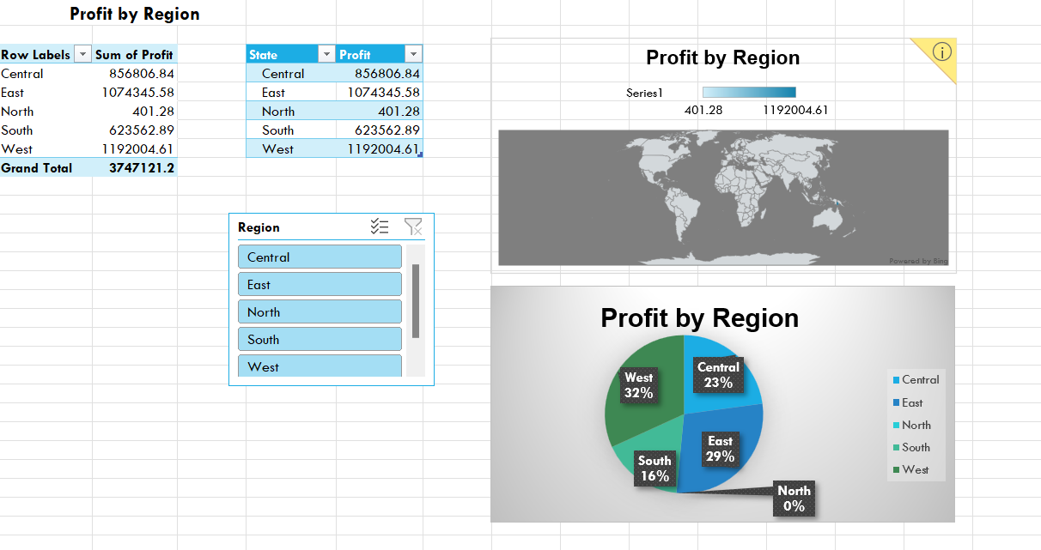
Profit by Region

Slide 7
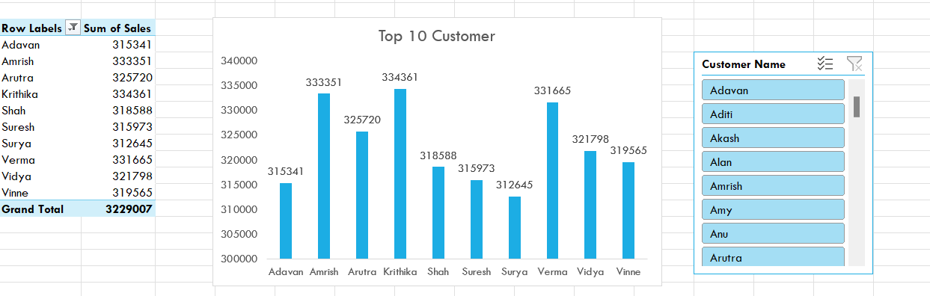
Top 10 Customer

Slide 8
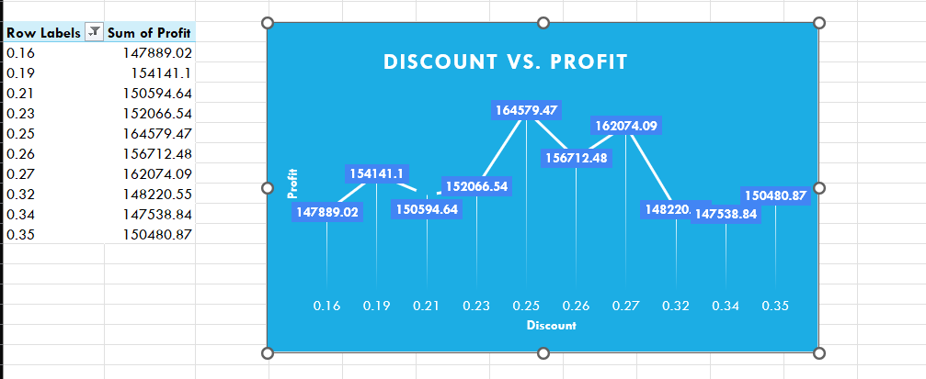
Discount vs. Profit

Slide 9
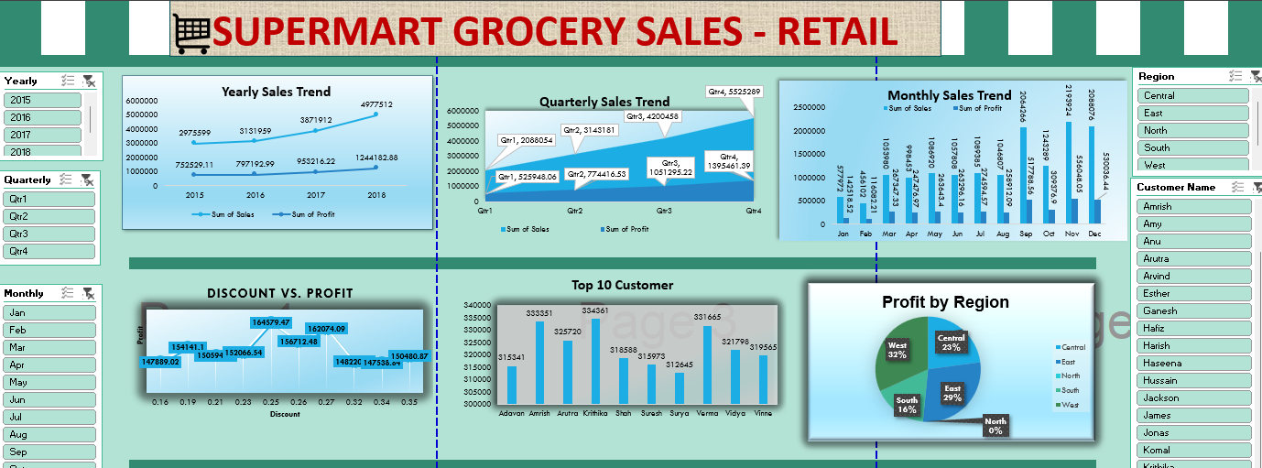
Supermart Grocery Sales – Retail Dashboard

Slide 10
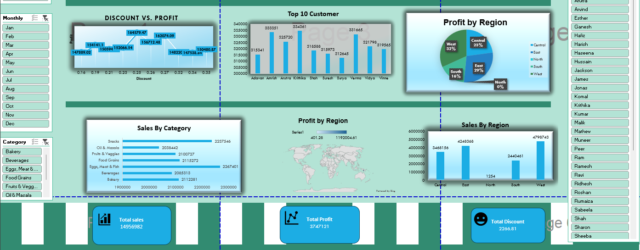

Slide 11
Supermart Grocery Sales - Retail Insights
1. Aggressive expansion drives sales growth.
2. Focus on East, West, and growing Central and South regions.
3. Retain high-value customers through loyalty programs.
4. Optimize for holiday seasons (Sep-Dec) and summer sales.
5. Efficient operations boost profits.

Slide 12
Supermart Grocery Sales - Retail Recommendations
Invest in marketing and customer engagement.
2. Optimize operations and inventory.
3. Develop loyalty programs.
4. Gather customer feedback.
5. Explore strategic partnerships.

Slide 13
THANK YOU

